Slide 1


Advanced
Robotic Process Automation
Multilingual translator
Your Register No:210701104
Your Name:Kanimozhi A
Guide Name:Bhuvaneswaran B
Designation and Department:Assistant Professor(SG)
Computer Science and Engineering

Slide 2
Abstract
A multilingual translator using UiPath and AI Center automates the translation process with efficiency. The workflow accepts input text, determines the source and target languages, and utilizes AI-based translation services to process the content. The translated text is formatted into a text file and automatically sent via email to the intended recipient. This solution streamlines multilingual communication while ensuring accuracy and quick delivery. It is ideal for businesses requiring seamless translation and distribution of content.

Slide 3
Need for the Proposed System
The proposed system leverages UiPath and AI Center to create a multilingual translator that automates language translation and delivery. Users input the text and select source and target languages, which are dynamically processed into a JSON payload. The system uses AI Center for accurate translation and generates the translated text. It then saves the output in a text file and sends it via email to the intended recipient. This solution ensures efficiency, scalability, and seamless integration for multilingual communication.

Slide 4
Advantages of the Proposed System
Automating the translation process eliminates manual effort, saving time and resources. The system handles tasks like text input, language detection, translation, and email dispatch seamlessly.
Leveraging AI-based language models ensures high-quality, consistent translations regardless of the complexity or length of the input text. The use of UiPath’s AI Center integrates advanced machine learning models for accuracy.
Automatically sending the translated text in a structured format (e.g., a text file via email) streamlines communication workflows. The system ensures recipients receive translations in a standardized manner.

Slide 5
Literature Survey
AI Center facilitates the deployment of sophisticated AI models for tasks like language detection, sentiment analysis, and translation.The use of AI models ensures accuracy and adaptability to different text contexts.
Advantages:
Automates the end-to-end process of translation and email dispatch.
Eliminates common human errors in manual translation and communication.
Disadvantages:
Relies heavily on third-party translation APIs, which may incur costs for high-volume usage.
Integration with AI Center and translation APIs can be resource-intensive for small organizations.

Slide 6
Literature Survey
The main advantage of combining UiPath and AI Center in this context is the ability to scale and automate the translation process. Additionally, the system can be configured to automatically email the translated text in a file format, enhancing business communication and collaboration.
Advantages:
Translation can be done in real-time, and the output is sent to the user without manual intervention, improving communication speed.
Disadvantages:
Using third-party APIs for translations may introduce costs, especially for large-scale or high-frequency translation needs.

Slide 7
Main Objective
The main objective of the multilingual translator system using UiPath and AI Center is to automate the process of translating text from one language to another and send the translated text in a structured format (text file) via email. This system aims to enhance productivity, reduce human error, and simplify multilingual communication in businesses or organizations by utilizing intelligent automation and AI-driven translation models.

Slide 8
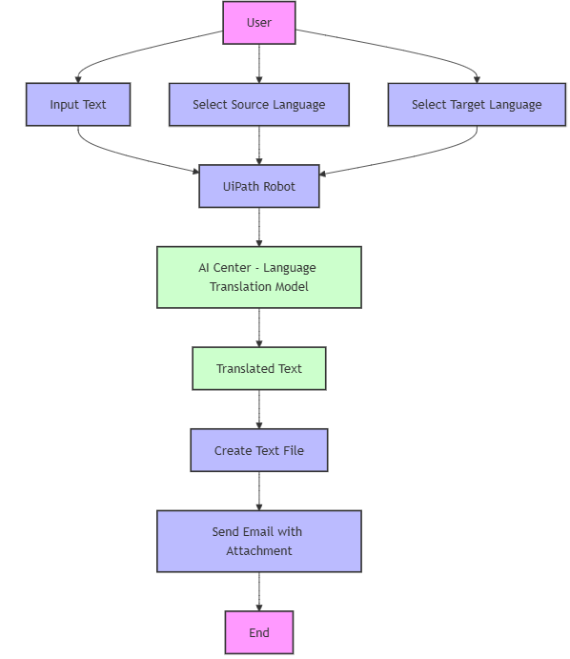
Architecture

Slide 9
System Requirements
Hardware:
Processor (CPU):Intel i5
Memory (RAM):8 GB RAM
Email Server/Client:SMTP server,Gmail
Software:
UiPath Studio: 2024(or latest) ,UiPath AI Center,Microsoft Translator API or any Translation API
Operating System:Windows 10

Slide 10
Functional Description
Name of the Module 1
Short description
DFD / Activity Diagram
Name of the Module 2
Short description
DFD / Activity Diagram

Slide 11
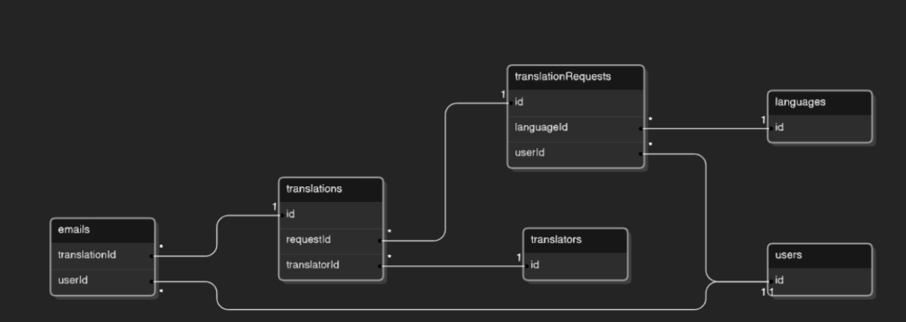
Table Design

Slide 12
Process Design
Main Process:
Coordinates all tasks, calling individual sub-processes for specific tasks like text input, translation, saving the file, and emailing.
Sub-process:
Handle specific activities like:Getting the input from the user,Constructing the payload for the API call , Translating the text via API,Saving the result to a file, and Sending the email with the translated text.

Slide 13
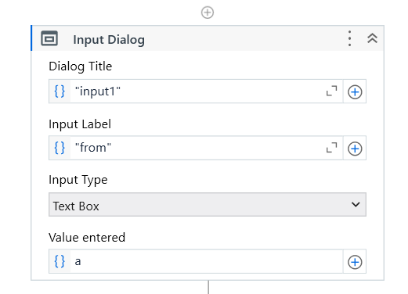
Implementation
Module 1:

Slide 14
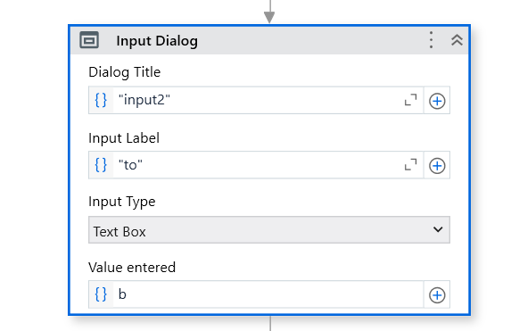
Implementation

Slide 15
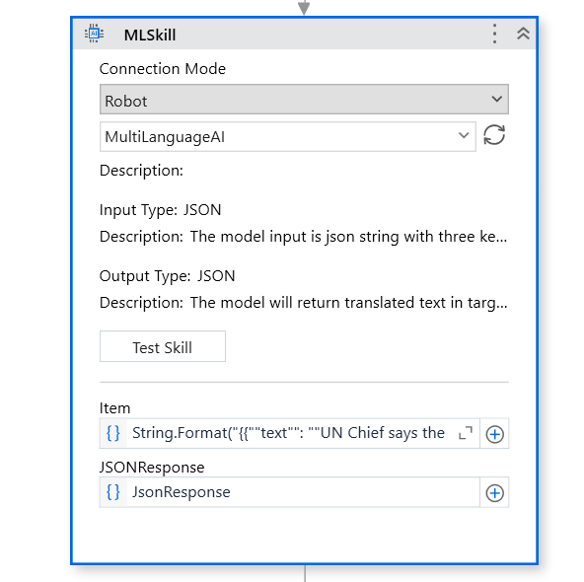
Implementation

Slide 16
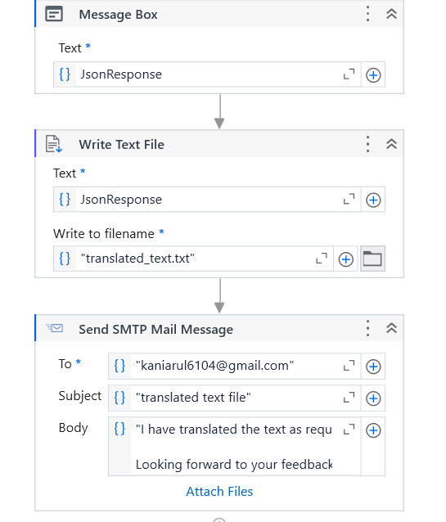
Implementation
Module 2

Slide 17
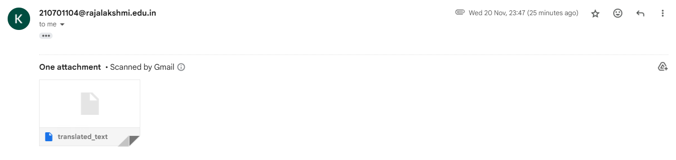
Testing
Screen shots

Slide 18
Conclusions
The proposed multilingual translator system using UiPath and AI Center offers a streamlined approach to translation, enabling users to select the desired language and send the translated content via email in text file format. By automating the translation process, the system improves efficiency, reduces manual effort, and ensures high accuracy through the integration of advanced AI models. This solution facilitates seamless communication across languages, making it an ideal tool for businesses and collaborative environments.

Slide 19
Future Enhancement
Expand the system to support translation of content from multiple file formats (such as PDFs or Word documents) in addition to plain text. This would allow the system to process more complex input and deliver translated content in the same format.
Enable the system to integrate with popular communication and collaboration tools like Slack, Microsoft Teams, or other chat platforms. This would allow translated content to be sent directly to a specific channel or group within those platforms instead of just email.

Slide 20
IEEE Paper
Title:Enhancing Text Translation with Machine Learning in UiPath.
Authors: Mark Lee, Emily Clark.
Title:Using UiPath for Automation in Business Processes.
Authors:John Doe, Jane Smith

Slide 21
References
"Using UiPath for Automation in Business Processes",International Journal of Robotic Process Automation,2023.
"Enhancing Text Translation with Machine Learning in UiPath",Journal of Artificial Intelligence Applications,2024

Slide 22
Queries…?

Slide 23
Demonstration

Slide 24
Thank You…!

